Slide 1
UGRADS, PCI Big Beam Competition
4-26-2018
By: Roy Crouch, Stephen Gergal, Fernando Rojo, and Brandy Wagoner

Slide 2



Project Background
PCI is a technical institute for the Precast/Prestressed Concrete industry.
Figure 1: Precast/Prestressed Concrete Institute logo [1]
This is the 9th year that NAU will be competing.
Figure 2: Northern Arizona University CEFNS logo [2]
This project is generously sponsored by Tpac, an Encon company.
Figure 3: TPAC logo [3]

Slide 3
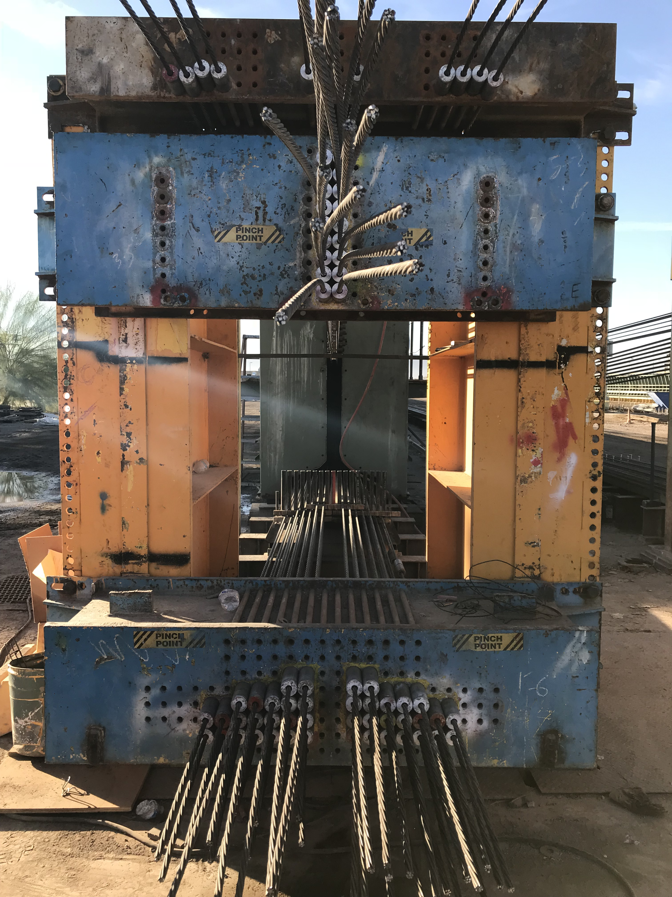
Precast/Prestressed Concrete
Precast - Concrete elements are cast off-site and shipped to the final in-service location.
Prestressed - Structural elements consist of reinforcing steel and high-strength steel strands which are pretensioned before the concrete is cast, and cut once the concrete has reached a certain strength. They apply a compressive force on the member, allowing it to carry greater loads and span greater distances than mildly reinforced members.
Figure 4: Prestressing strand anchoring device (photo by Roy Crouch)
Notes:
I think this slide has to many words, should we try to shorten it out?

Slide 4

The Competition
Judging Criteria
Design accuracy.
Lowest cost.
Lowest weight.
Largest measured deflection at maximum total applied load.
Most accurate prediction.
Report quality.
Practicality, innovation, and conformance to code.
Competition Design Objective
Design a precast/prestressed beam for a cracking capacity of 20 kips and an ultimate capacity between 32 and 39 kips, while minimizing cost and weight and maximizing deflection for prescribed loads.
Figure 5: Tpac logo [1]
Figure 6: Northern Arizona University logo [2]

Slide 5
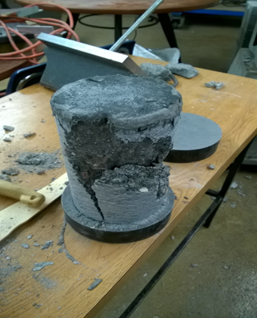
Mix Design
Table 1: Concrete mixes
Normal Weight Mixtures | Cement | Fly Ash | Normal Weight Coarse Aggregate | Fine Aggregate | W/C Ratio
Tpac NW | 730 | 185 | 1,484 | 1,268 | 0.31
NAU #1 NW | 623 | 267 | 1,550 | 1,288 | 0.30
NAU #3 NW | 600 | 356 | 1,390 | 1,360 | 0.29
LightweightMixtures | Cement | Fly Ash | Lightweight Coarse Aggregate | Fine Aggregate | W/C Ratio
Tpac LW | 730 | 185 | 867 | 1,328 | 0.34
NAU #2 LW | 610 | 261 | 150* | 1,200 | 0.31
NAU #4 LW | 600 | 356 | 940 | 1,070 | 0.34
Figure 7: Broken Cylinder after compressive test (taken by Stephen Gergal)
*Pumice used as aggregate
Notes:
Can we add a table here to show everyone what each mix was made of? Like cement type, aggregate, and pozzolan?

Slide 6
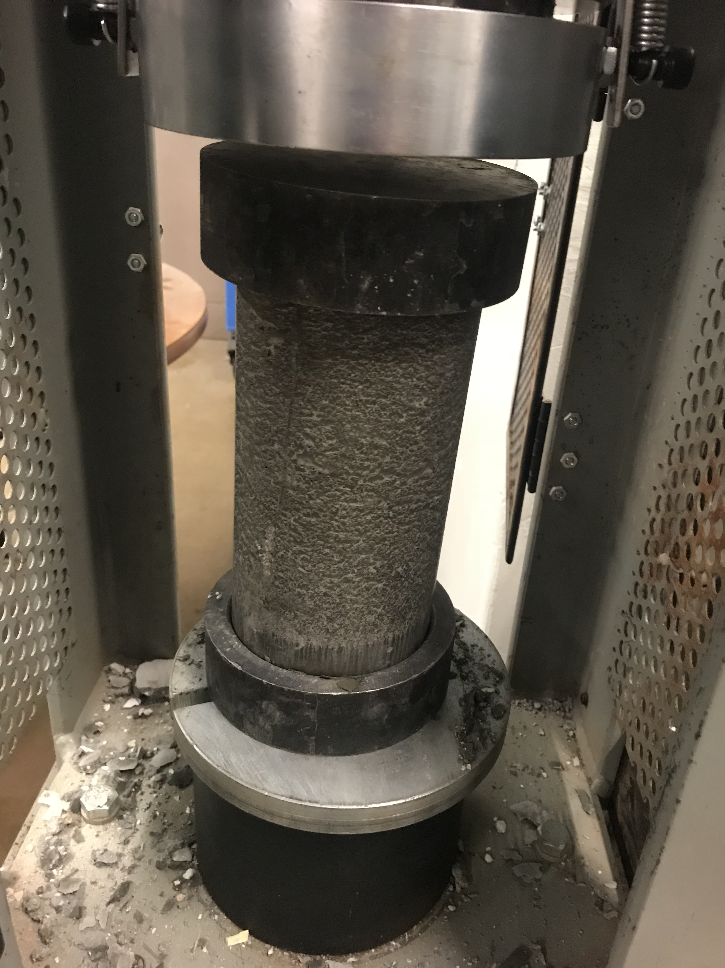
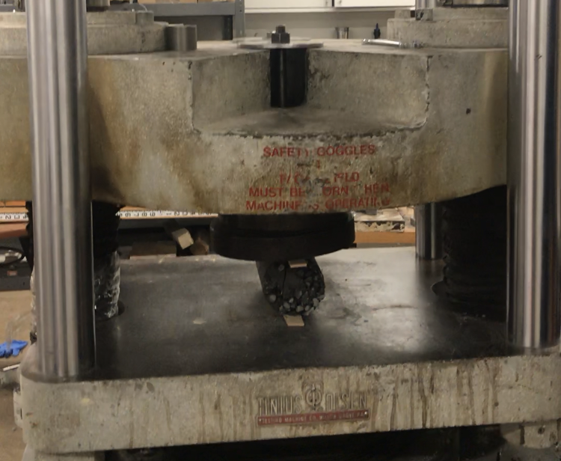
Mix Testing Results
Compressive strength test
Table 2: Mix testing results
Normal Weight Mixtures | Unit Weight (pcf) | Compressive Strength (psi) | Tensile Strength (psi) | Modulus of Elasticity (ksi)
Tpac NW | 148.3 | 10,000 | 349 | 5,700
NAU #1 | 148.1 | 7,130 | 474 | 4,813
NAU #3 | 147.3 | 2,360 | 239 | 2,769
Photo courtesy: Fernando Rojo
Tensile strength test
Lightweight Mixtures | Unit Weight (pcf) | Compressive Strength (psi) | Tensile Strength (psi) | Modulus of Elasticity (ksi)
Tpac LW | 126.0 | 8,000 | 505 | 5,098
NAU #2 | 126.8 | 1,312 | 230 | 2,064
NAU #4 | 118.1 | 1,526 | 150 | 2,227
Photo courtesy: Fernando Rojo
Notes:
This slide would need just a table, showing the results from each test done

Slide 7
Mix Scoring
Table 3: Concrete Mix Decision Matrix
Mixes | Unit Weight (pcf) | Rank | Compressive Strength (psi) | Rank | Tensile Strength (psi) | Rank | Modulus of Elasticity (ksi) | Rank | Score
Tpac NW | 148.3 | 1 | 10,000 | 6 | 349 | 4 | 5,700 | 1 | 3.5
NAU #1 NW | 148.1 | 2 | 7,130 | 4 | 474 | 5 | 4,813 | 3 | 3.75
NAU #3 NW | 147.3 | 3 | 2,360 | 3 | 239 | 3 | 2,769 | 4 | 3.3
Tpac LW | 126 | 5 | 8,000 | 5 | 505 | 6 | 5,098 | 2 | 4.35
NAU #2 LW | 126.8 | 4 | 1,312 | 1 | 230 | 2 | 2,064 | 6 | 3.05
NAU #4 LW | 118.1 | 6 | 1,526 | 2 | 150 | 1 | 2,227 | 5 | 3.05
Weighted Factor |  | .10 |  | .35 |  | .25 |  | .30
*LW - Lightweight concrete mix
*NW – Normal weight concrete mix
Notes:
Decision matrix of how we chose the TPAC LW mix

Slide 8
Final Mix Design: TPAC’s LW Mix
Table 4: Tpac LW Composition
Table 5: Tpac LW Characteristics
Material | Weight (lbs/CY) | Volume (CF/CY)
Cement | 730 | 3.71
Admixture (30% Fly Ash) | 185 | 1.35
Coarse Aggregate | 867 | 8.58
Sand | 1,328 | 8.15
Water | 308 | 4.94
Air Entrainment | 1% | 0.27
Admixtures
Advacast 575 | Improves Workability
VmarF 100 | Improves Consolidation
Recover | Stabilizes Hydration
3 Day Strength (psi) | 5,000
28 Day Strength (psi) | 8,000
W/C Ratio | 0.337
Unit Weight (pcf) | 126.0
Notes:
Give details about mix design, very large writing, and easy to read table.

Slide 9
Cross Section Design
Decision matrix is scored on:
Lowest cost
Lowest weight
Largest deflection
MathCAD model is designed to analyze:
Stresses at release
Cracking load
Ultimate capacity
Shear capacity
Each cross section is analyzed for:
20 kip cracking capacity
Ultimate failure between 32 and 39 kips
Scoring = (value- worst value)
(best value - worst value)

Slide 10
Beam Scoring
Table 6: Decision matrix for the selection of a cross section using parameters defined by PCI.
X-Section Considered | Cost ($) | Rank | Weighted Factor | Weight of Section (plf) | Rank | Weighted Factor | Defl. (in) | Rank | Weighted Factor | Total Score
I Beam #1 | 71 | 5 | 0.745 | 108.0 | 6 | 0.306 | 0.019 | 3 | 0.579 | 1.629
I Beam #2 | 62 | 4 | 0.929 | 78.00 | 4 | 0.833 | 0.010 | 8 | 0.078 | 1.839
I Beam #3 | 59 | 2 | 0.997 | 69.00 | 2 | 0.996 | 0.017 | 6 | 0.495 | 2.489
Box Beam #1 | 100 | 9 | 0.116 | 126.0 | 10 | 0.000 | 0.023 | 2 | 0.795 | 0.911
Bulb T | 60 | 3 | 0.964 | 75.00 | 3 | 0.882 | 0.009 | 9 | 0.016 | 1.862
C Beam | 79 | 6 | 0.560 | 108.0 | 5 | 0.318 | 0.011 | 7 | 0.085 | 0.963
* Box Beam #2 | 59 | 1 | 1.000 | 68.00 | 1 | 1.000 | 0.018 | 5 | 0.520 | 2.520
I Beam #4 | 80 | 7 | 0.549 | 109.00 | 7 | 0.302 | 0.008 | 10 | 0.000 | 0.852
I Beam #5 | 106 | 10 | 0.000 | 125.00 | 9 | 0.006 | 0.027 | 1 | 1.000 | 1.003
T Beam | 89 | 8 | 0.366 | 120.00 | 8 | 0.114 | 0.018 | 4 | 0.522 | 1.002
* Selected cross section

Slide 11
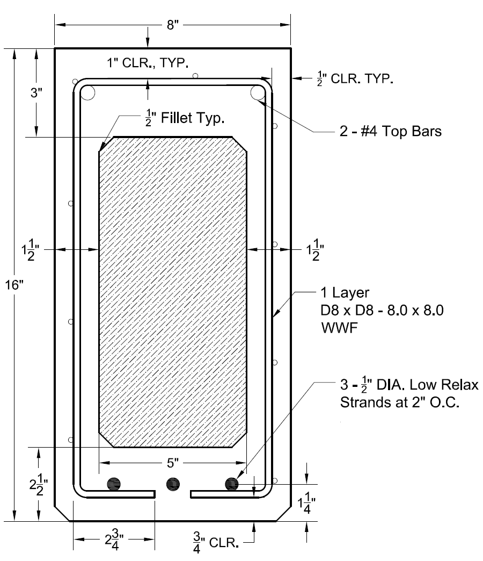
Final Beam Design
Materials:
Tpac’s light weight concrete
#4 Compression Steel
Prestressing strands
Welded Wire Fabric (WWF)
Styrofoam in void
Design:
Concrete unit weight:126 pcf
Total weight: 1,500 lbs
Prestressing strands pulled to 31 kips each
Void
Figure 8: Final cross section design of beam

Slide 12
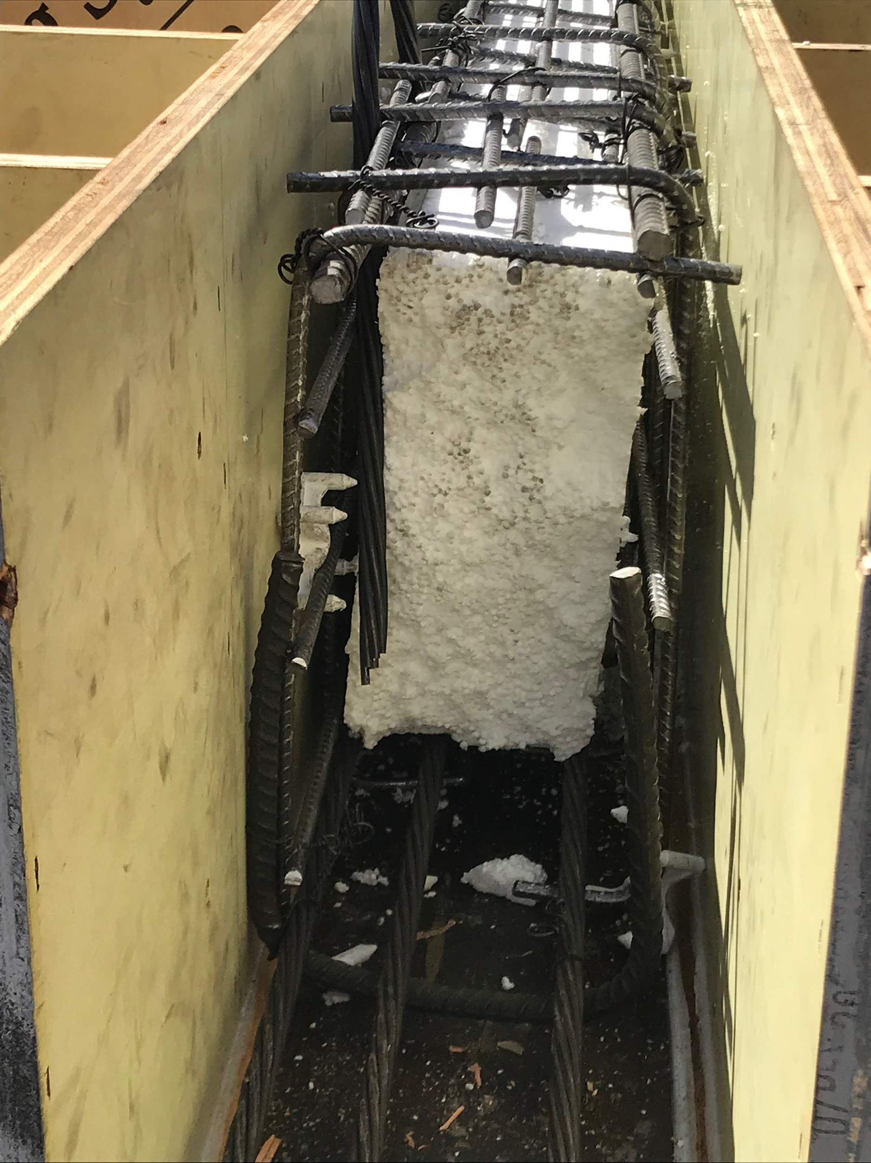
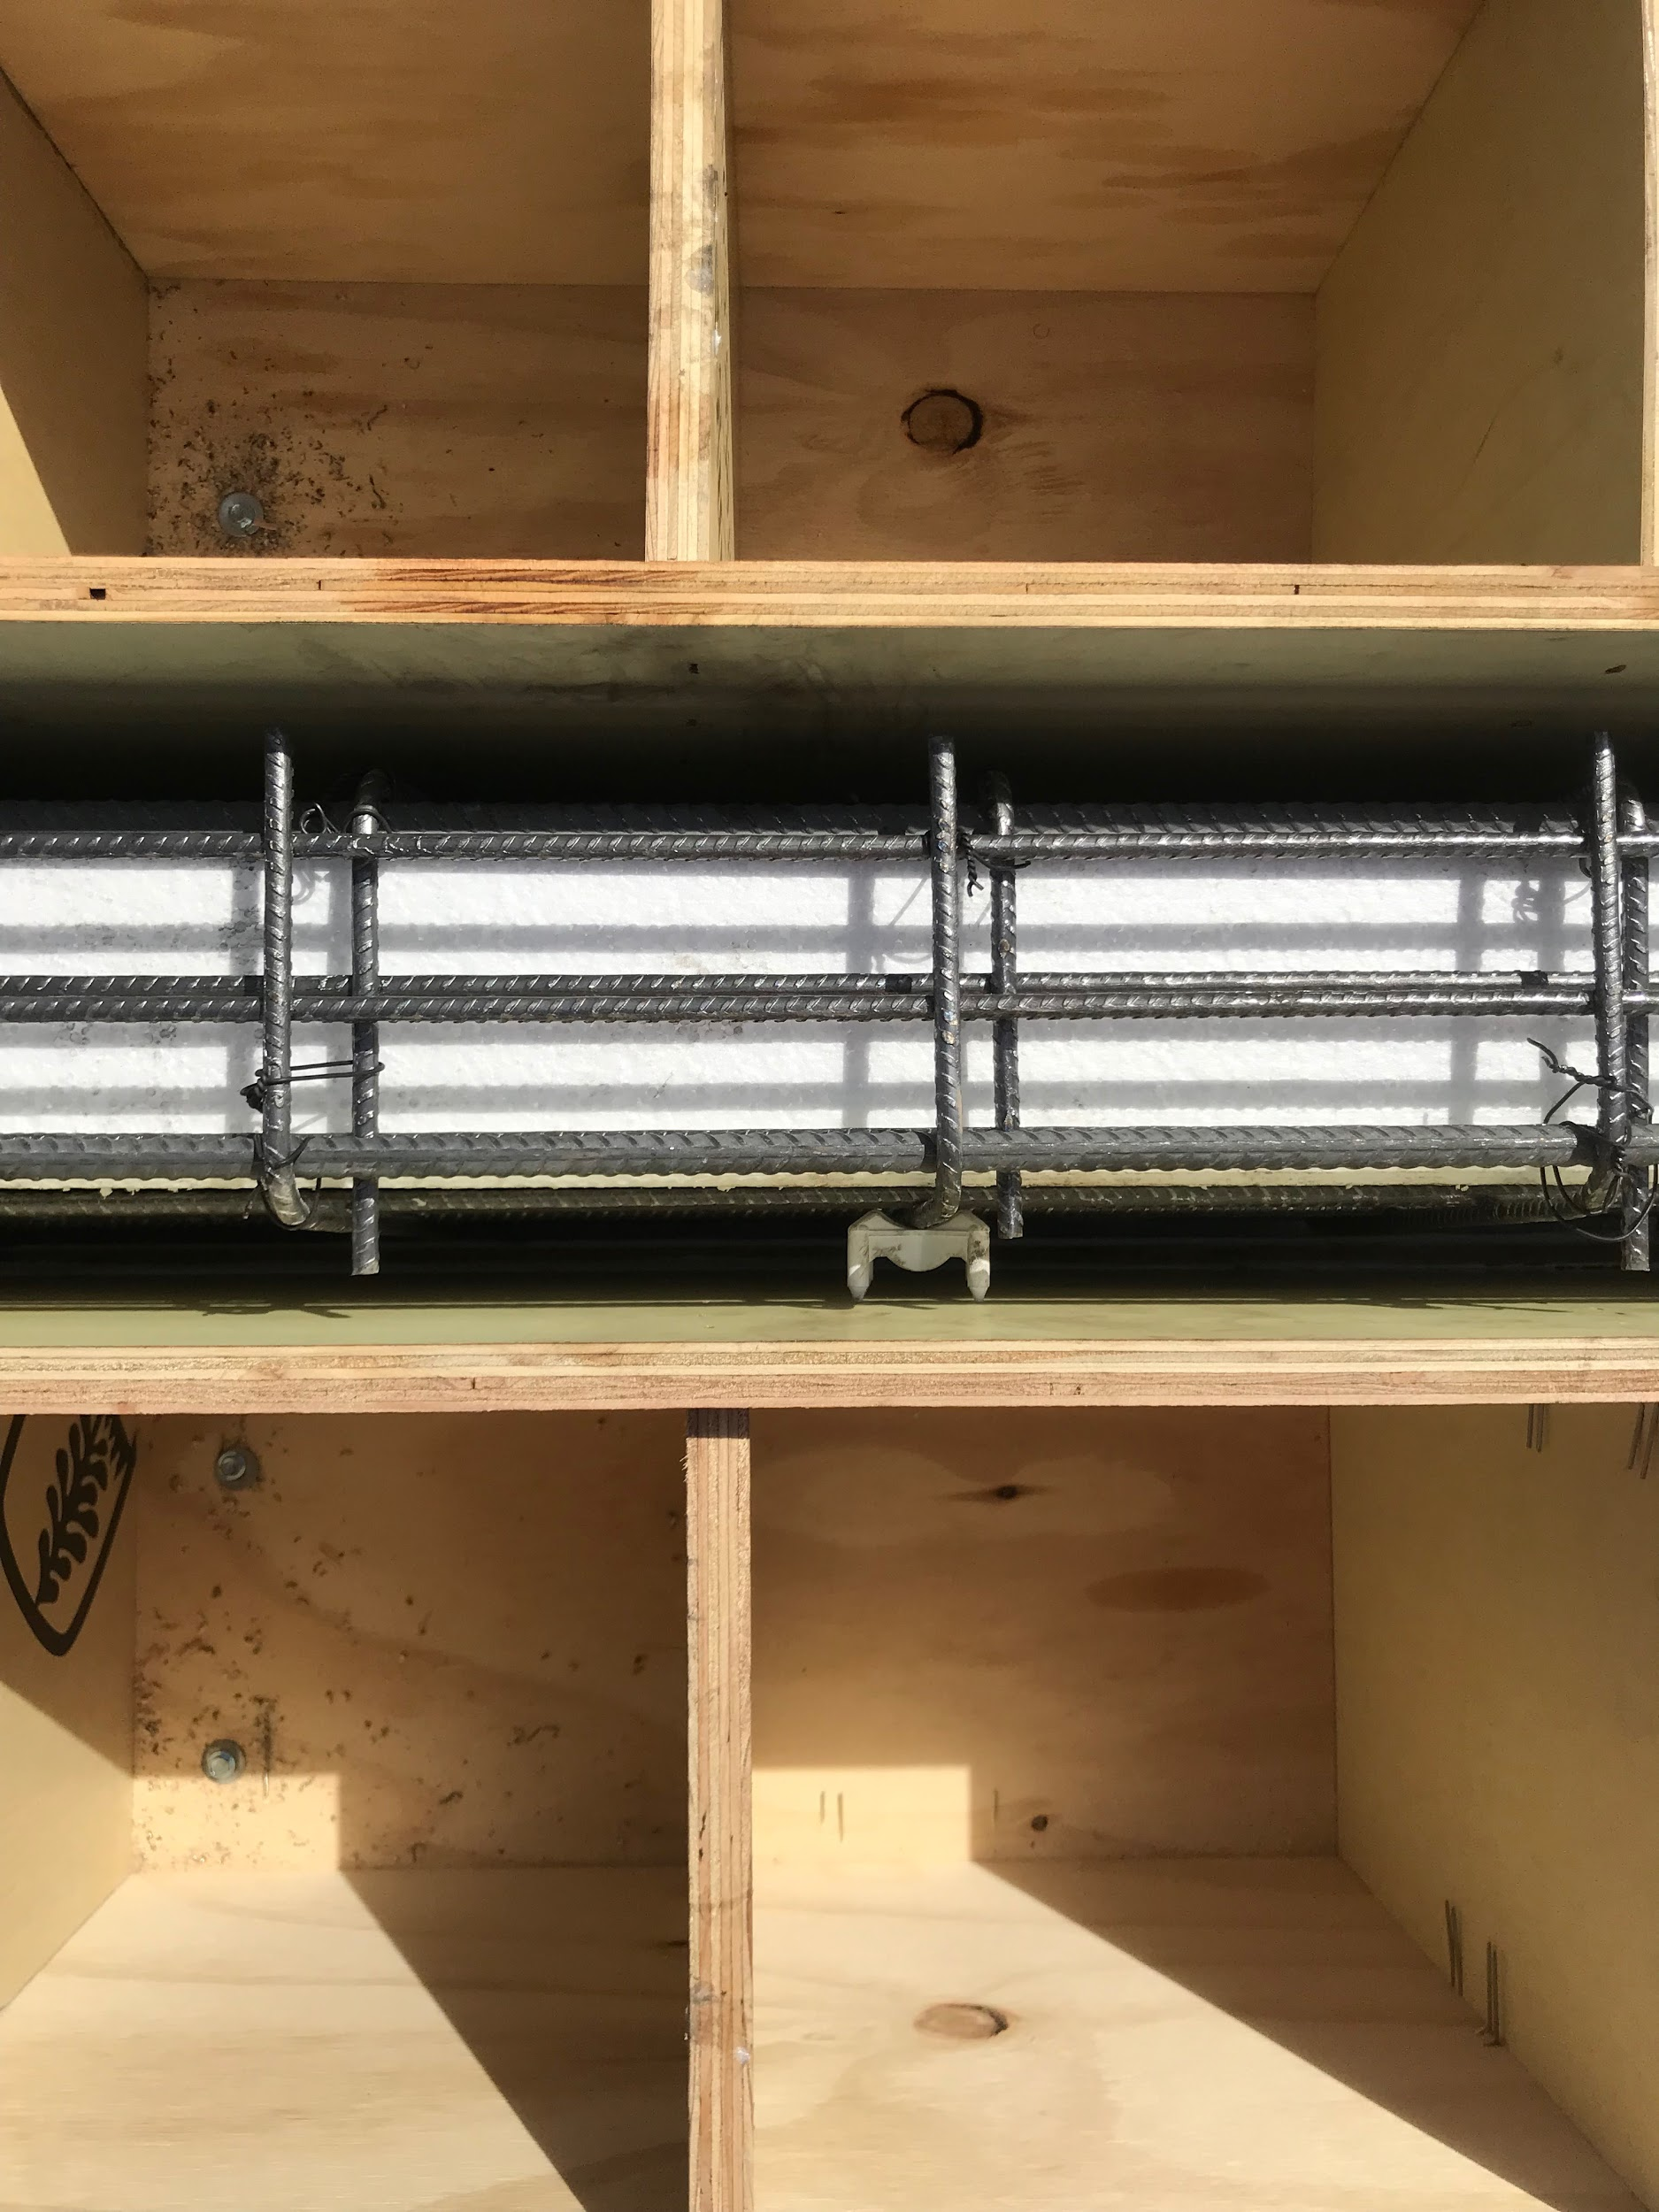
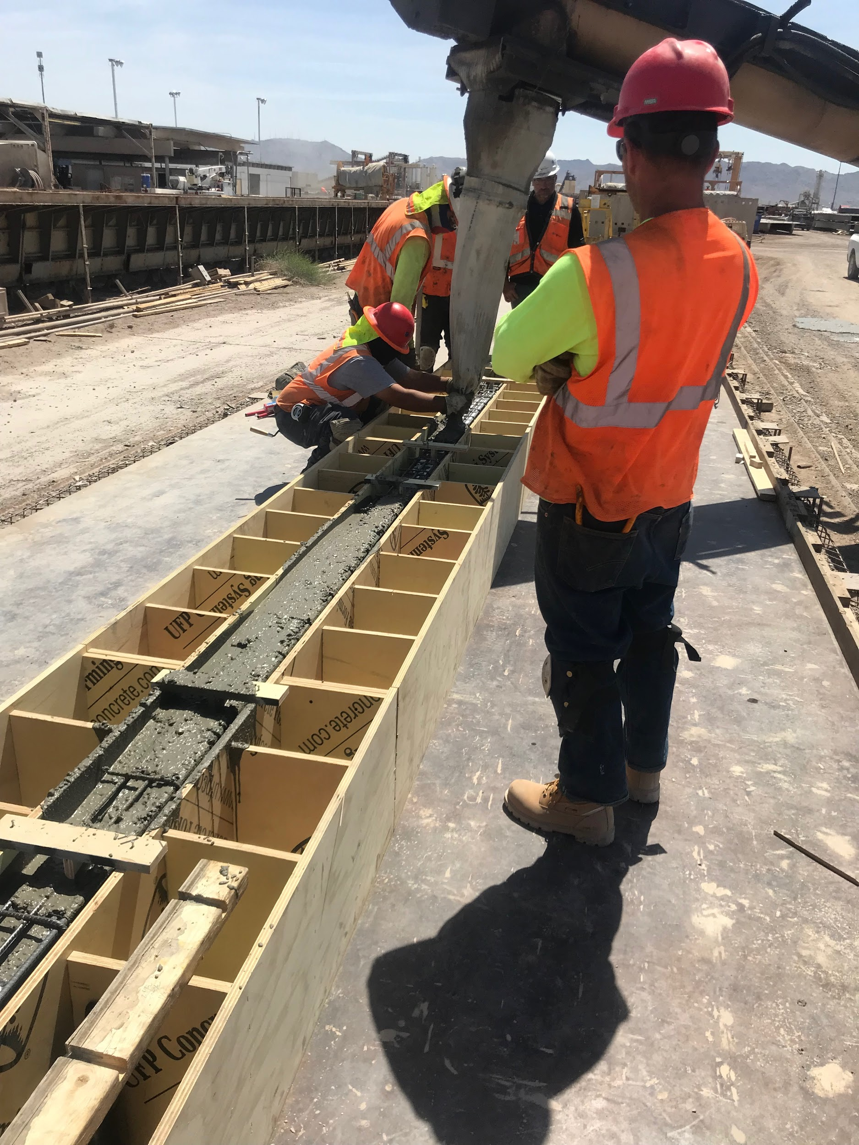
Beam Fabrication
Figure 9: End view of beam before casting. Picture courtesy of Brandy Wagoner
Figure 10: Top view of beam before casting. Picture courtesy of Brandy Wagoner
Figure 11: Concrete beam being cast in the custom built form. Picture courtesy of Brandy Wagoner

Slide 13
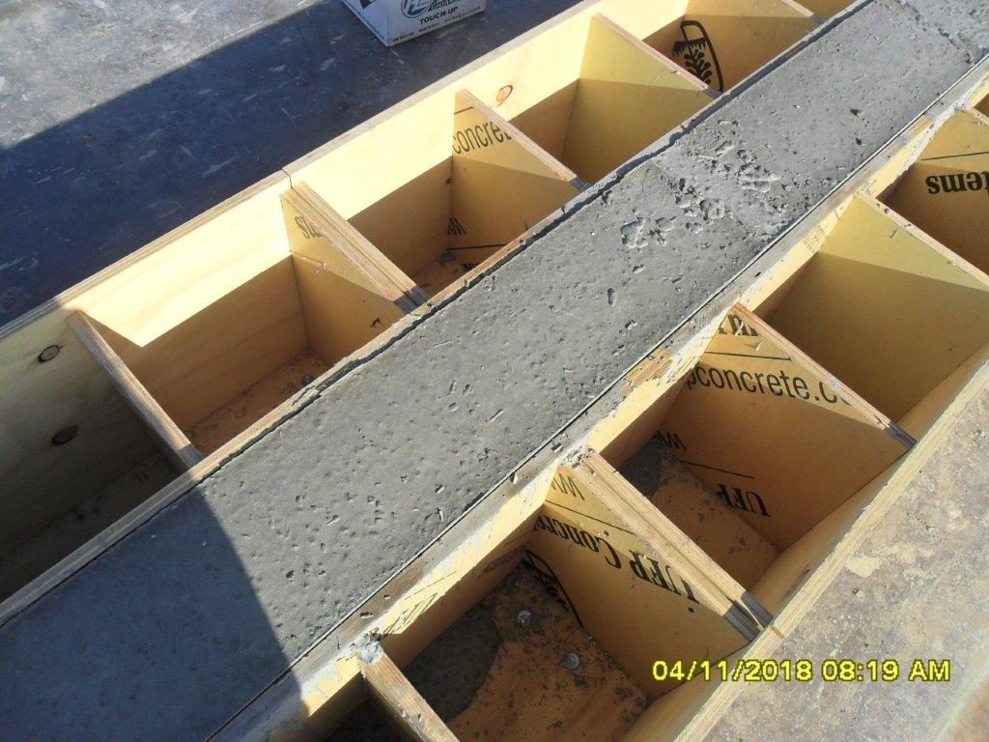
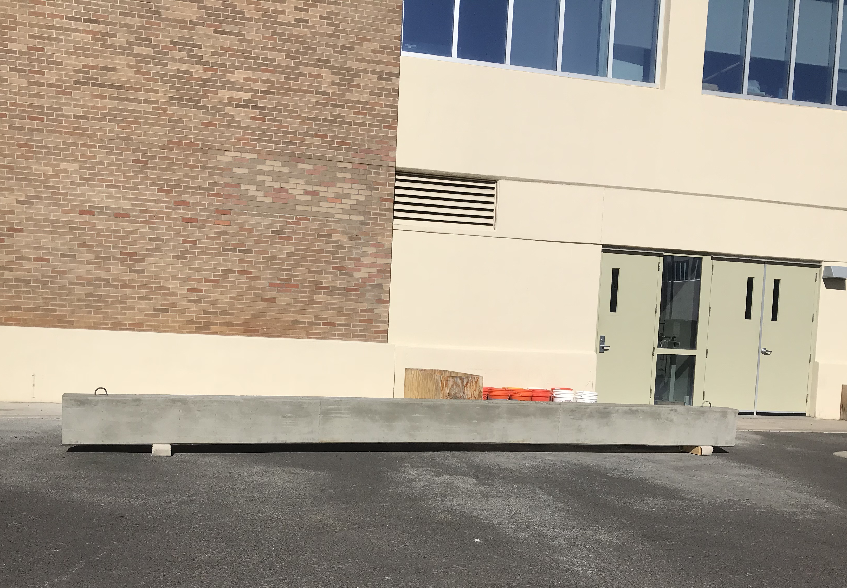
Final Beam
Figure 12: Beam casting, still inside form.
Photo Courtesy: TPAC
Figure 13: Beam sitting outside NAU concrete lab
Photo Courtesy: Fernando Rojo

Slide 14



Prediction Calculations
$$Pn=\frac{\left(M_{n}−M_{sw}\right)∗2}{8ft}=33.4 kip$$
$$Pcr=\frac{2∗(M_{LL})}{8ft}=20.7 kip$$
Equation 1: Failure Load
Equation 2: Cracking Load
$$σ_{t}=σ_{a}−σ_{f}=843 psi \left(Tension\right)$$
$$σ_{b}=σ_{a}+σ_{f}=2819 psi (Compression)$$
Equation 3: Stresses experienced

Slide 15
Staffing
Table 7: Actual total project hours
Table 8: Predicted total project hours
Staffing
Task | S. ENG | ENG | Lab | AA | Total
Mix Design | 15 | 50 | 45 | 20 | 130
Mix Testing | 5 | 35 | 95 | 10 | 145
Beam Design | 15 | 45 | 8 | 5 | 73
Beam Manufacturing | 5 | 20 | 10 | 8 | 43
Prediction Calculations | 20 | 40 | 5 | 5 | 70
Testing | 10 | 40 | 90 | 10 | 150
Report | 12 | 35 | 15 | 35 | 97
Total Hours | 82 | 265 | 268 | 93 | 708
Staffing
Task | S. ENG | ENG | Lab | AA | Total
Mix Design | 15 | 45 | 45 | 20 | 125
Mix Testing | 5 | 30 | 85 | 10 | 130
Beam Design | 15 | 40 | 5 | 5 | 65
Beam Manufacturing | 5 | 15 | 6 | 5 | 31
Prediction Calculations | 18 | 35 | 5 | 5 | 63
Testing | 10 | 35 | 80 | 10 | 135
Report | 10 | 30 | 10 | 25 | 75
Total Hours | 78 | 230 | 236 | 80 | 624
S. Eng = Senior Engineer
ENG = Engineer
LAB = Lab Technician
AA = Administrative Assistant

Slide 16
Cost
Table 9: Actual cost of project
Table 9: Predicted cost of project
Budget
Staffing | Personal | Hours | Billing Rate ($/hr) | Cost ($)
 | S. ENG | 82 | 130 | 10,660
 | ENG | 265 | 70 | 18,550
 | LAB | 268 | 40 | 10,720
 | AA | 93 | 35 | 3,255
Lab Use |  | 90 | 100 | 9,000
Beam Fabrication/Shipping |  |  |  | 5,000
Travel Costs |  |  |  | 400
Total cost of project ($) |  |  |  | 57,585
Budget
Staffing | Personal | Hours | Billing Rate ($/hr) | Cost ($)
 | S. ENG | 78 | 130 | 10,140
 | ENG | 230 | 70 | 16,100
 | LAB | 236 | 40 | 9,440
 | AA | 80 | 35 | 2,800
Lab Use |  | 75 | 100 | 7,500
Beam Fabrication/Shipping |  |  |  | 5,000
Travel Costs |  |  |  | 400
Total cost of project ($) |  |  |  | 51,380

Slide 17
Schedule
Table 9: Project Schedule
Task | Anticipated end date | Actual end date
Mix Test results | 01-19-2018 | 01-19-2018
Mix Selection | 01-26-2018 | 01-26-2018
MathCad Model | 01-26-2018 | 01-26-2018
Beam Selection | 01-31-2018 | 02-20-2018
Shop Drawing | 02-14-2018 | 03-06-2018
Prediction Calculations | 02-14-2018 | 02-14-2018
Beam Manufacturing | 03-8-2018 | 04-06-2018
Testing | 03-19-2018 | 05-04-2018
Video | 03-22-2018 | 05-07-2018
Final Report (NAU) | 04-2-2018 | 05-10-2018
Final Report (PCI) | 04-6-2018 | 05-10-2018

Slide 18
References
[1] TPAC, "TPAC Official Website," [Online]. Available: tpacaz.com. [Accessed 30 11 2017].
[2] Northern Arizona University, "NAU CEFNS," 21 04 2018.
[3] Precast/Prestressed Concrete Institute, "PCI," [Online]. Available: pci.org.
[Accessed 30 11 2017].
[4] PCI, "2018 PCI Big Beam Brochure," [Online]. [Accessed 30 11 2017].

